Slide 1

PORTFOLIO RISK ANALYTICS
EARLY WARNING & WATCHLIST REVIEW
Cleane
Data Cleaning
Validation & Integrity
ervice
warning_amber
Anomaly Detection
Early Risk Identification
insights
Predictive Modelling
Forward-Looking Analytics
shield
Portfolio Risk
Comprehensive Assessment
Presented By
Mary Ojelabi
person

Slide 2


PORTFOLIO RISK ASSESSMENT
Business Context & Problem Statement
account_balanceBUSINESS CONTEXT
The bank has extended a ₦20 million credit facility to a cafe and seeks to evaluate the borrower’s financial performance and overall credit risk position.
track_changesKEY QUESTIONS
01. Did café sales genuinely decline in H2, or was the drop caused by data-quality issues?
02. Is the café meeting its financial loan covenants?
03. Should the café remain Normal, move to Watch, or be considered for Restructure?
help_outlineCORE BUSINESS QUESTION
Should the bank continue to monitor the café under its normal portfolio process, or do the observed financial and credit-risk indicators justify placing the ₦20 million exposure on a watchlist?

Slide 3
PROJECT SCOPE & OBJECTIVES
PROJECT OBJECTIVES
analytics
01. Assess Borrower Performance
Sales and Financial Health
warning_amber
02. Identify Early Warning Signs
Revenue and transaction anomalies
assignment
03. Evaluate Financial Covenants
Key financial Ratios
speed
04. Benchmark Credit Risk
Historical Borrower comparison
insights
05. Evaluate Predictive Models
Credit risk classification
verified
06. Recommend Portfolio Action
Monitoring and Watchlist decisions

Slide 4


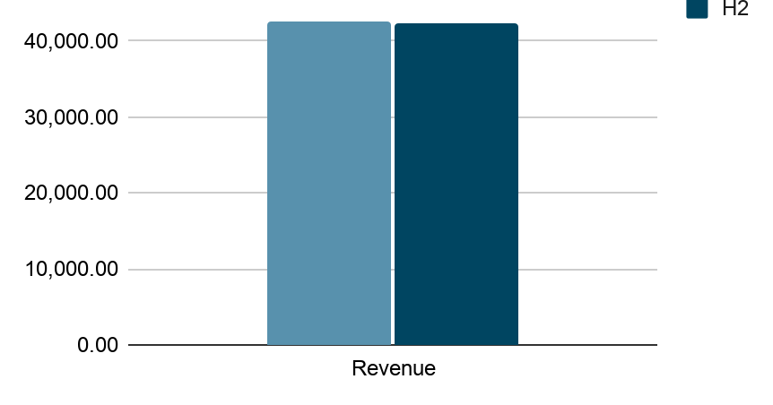
SALES PERFORMANCE
H1 vs H2 Revenue Analysis
H1 Revenue
42.55K
H2 Revenue
42.24K
Revenue Change
-0.73%
bar_chart Revenue Distribution
insights Key Findings
Cafe revenue declined marginally by 0.73% in H2 compared with H1.
This indicates broadly stable sales performance across periods rather than a significant operational decline.

Slide 5
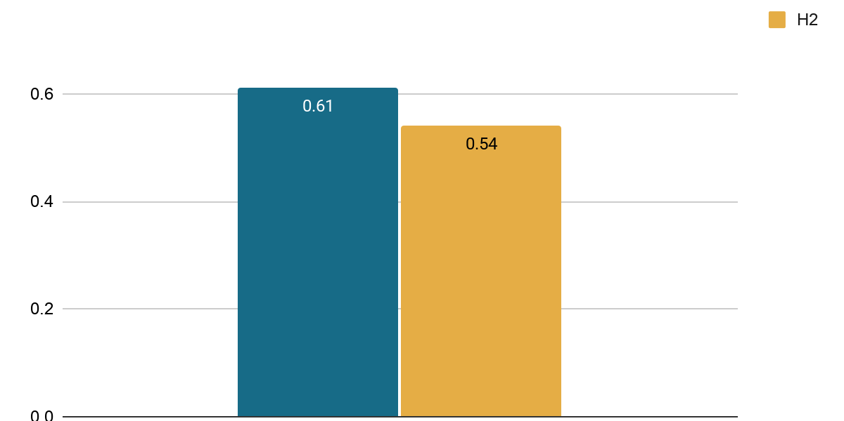
DATA QUALITY
Data Quality: Is the Decline Genuine?
H1 Unrecoverable Records
0.61%
H2 Unrecoverable Records
0.54%
Data Quality Gap
0.07 pp
bar_chart Unrecoverable Share Comparison
insights Key Findings
H2 had a slightly lower unrecoverable-record share than H1. The data-quality gap was only 0.07 percentage points, well below the 5-percentage-point threshold.
Therefore, missing or unrecoverable records do not explain the H2 sales movement.

Slide 6
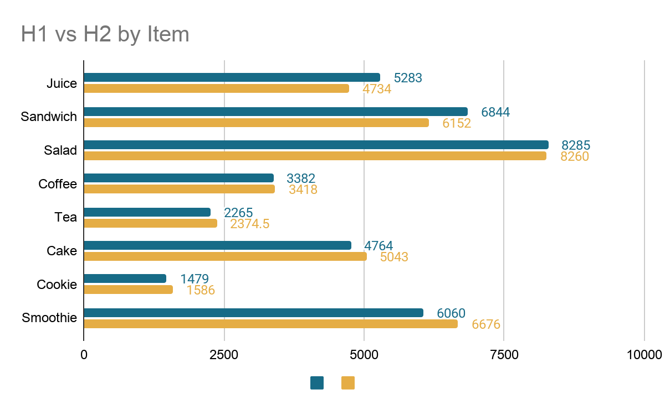
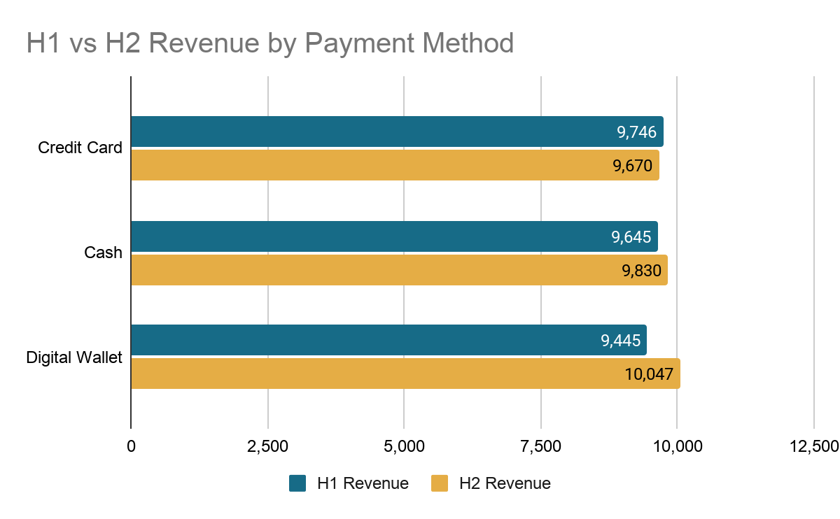
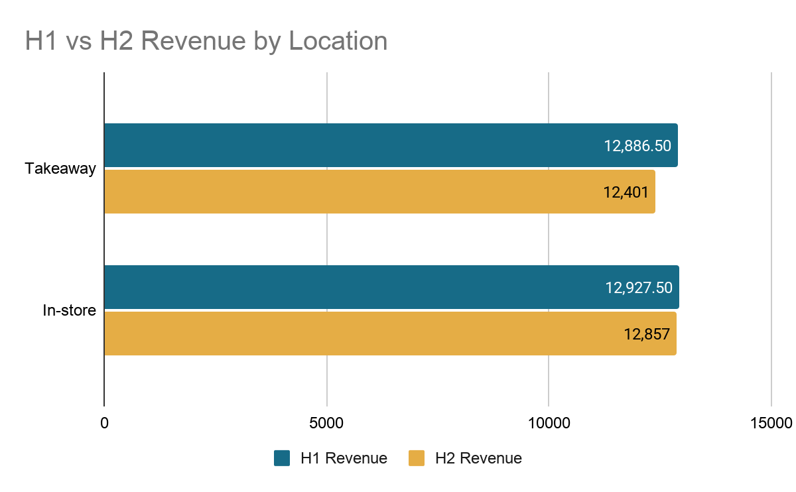
DETAILED BREAKDOWN
Sales Drivers: Items, Payment Methods & Service Style
fastfood By Item
credit_card By Payment Method
storefront By Service Style
Juice (-10.39%) and Sandwich (-10.11%) recorded the largest revenue declines.
Smoothie (+10.17%) achieved the strongest revenue growth.
Credit card revenue declined slightly by 0.78%, while Cash & Digital Wallet grew.
Digital Wallet recorded the strongest increase at 6.37%.
Both locations recorded lower H2 revenue.
Takeaway experienced a larger decline at 3.77%, vs 0.55% for in-store sales.

Slide 7
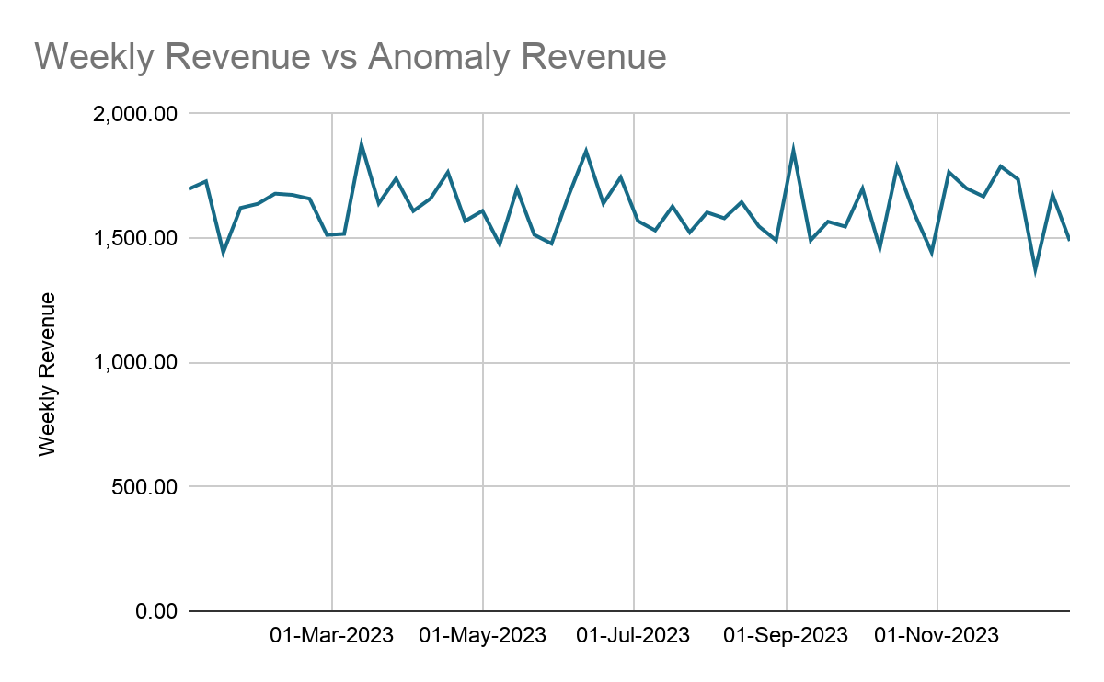
WEEKLY TRENDS
Weekly Trends & Anomalies
trending_up Weekly Revenue vs Anomaly Revenue
warning_amber Anomaly Assessment
176 26 December 2022
One unusually low weekly revenue observation was flagged. It represents a partial opening week with only 20 transactions.
insights Bank Monitoring Implication
The cafe's weekly revenue should be monitored to see if there are unusual drops or a continuous decline that could affect its ability to repay the loan.
Anomaly

Slide 8
COVENANT ASSESSMENT
Financial Covenant Assessment
Net Profit Margin PASS
16.46%
Threshold: ≥10%
Interest Cover PASS
62.76
Threshold: ≥ 2.0
Current Ratio PASS
7.49
Threshold: ≥ 1.20
Year | Net Profit Margin | Current Ratio | Interest Coverage
2018 | 17.45% | 5.17 | 49.07
2019 | 22.87% | 14.64 | 70.5
2020 | 16.46% | 7.49 | 62.76
task_alt KEY INSIGHT
All three financial covenants were met throughout the period reviewed. The café maintained strong profitability, liquidity and ability to cover interest expenses.

Slide 9
PORTFOLIO OVERVIEW
Historical Borrower Risk Patterns
Borrowers Analysed
20,000
Avg Age
43 yrs
Avg Credit Score
648.54
Avg Loan Amount
₦ 39,317.75
Avg Payment Delays (6m)
1.49
Avg Debt-to-Income
67.39%
Avg Credit Utilization
28.54%
Avg Existing Debt
₦ 52,668.68
insights Key Findings
The portfolio has an average debt-to-income ratio of 67.39% and 1.49 payment delays over six months, indicating potential repayment pressure.
warning_amber Data Limitation
All 20,000 records are classified as defaults, with PD values ranging from 99.67% to 100%. The absence of non-default observations limits meaningful comparison and predictive model validation. Hence, the above descriptive risk analysis was used.

Slide 10
MODEL EVALUATION
Predictive Model Performance
Assessment of model suitability and limitations of the available loan book data
Total Borrowers
20,000
Unique Default Class
1
PD Range
99.67%–100%
error_outline Model Limitations
All 20,000 borrowers are classified as defaulters.
No non-default records are available for comparison.
Model training and performance evaluation (ROC-AUC and default capture rate) cannot be reliably performed.
task_alt CONCLUSION
The loan book data must be corrected to include both default and non-default outcomes before a reliable predictive model can be developed and evaluated.

Slide 11
RISK ASSESSMENT
Café Risk Assessment & Limitation
Assessment of the café's repayment risk based on sales performance, financial covenants and available borrower information
Sales Performance
-0.73%
H2 revenue declined slightly against H1
Data Quality
H2 data quality was not worse than H1
Unrecoverable data was lower in H2 (0.54%) than H1 (0.61%).
Financial Covenants
3/3 Pass
All three financial covenants passed
gavel Bank Classification Criteria
Normal: No covenant breaches and PD below 20%.
Watch: One covenant breach or PD between 20% and 39%.
Restructure: Two or more covenant breaches or PD of 40% and above
warning_amber Café's Current Position: Pending Final Classification
The café has passed all three reported financial covenants, with a slight H2 revenue decline of 0.73%. However, a reliable café-specific PD is unavailable. Therefore, a final classification under the bank's criteria cannot yet be established.

Slide 12
RECOMMENDATIONS & NEXT STEPS
Portfolio Recommendations & Action Plan
Recommended actions to strengthen credit risk monitoring and manage the café's repayment risk
groups 01. OWNER ENGAGEMENT
Meet with the café owner to investigate the 0.73% revenue decline and assess its impact on the ₦20 million loan repayment capacity.
receipt_long 02. FINANCIAL AUDIT
Obtain complete financial statements and supporting expense records to verify covenant compliance and assess the café's financial position.
account_balance_wallet 03. CASH FLOW REVIEW
Review the café's cash flow against its loan repayment schedule to determine its ability to meet upcoming repayments and identify any likely shortfall.
tune MONITORING & FOLLOW-UP FRAMEWORK
Normal - Relax — Maintain routine monitoring where repayment performance is satisfactory and no major risk indicators are present.
Watch - Hold — Maintain the existing credit exposure while increasing monitoring and following up on emerging risks.
Restructure - Tighten — Intensify monitoring, restrict additional credit exposure and assess the need for loan restructuring.

Slide 13
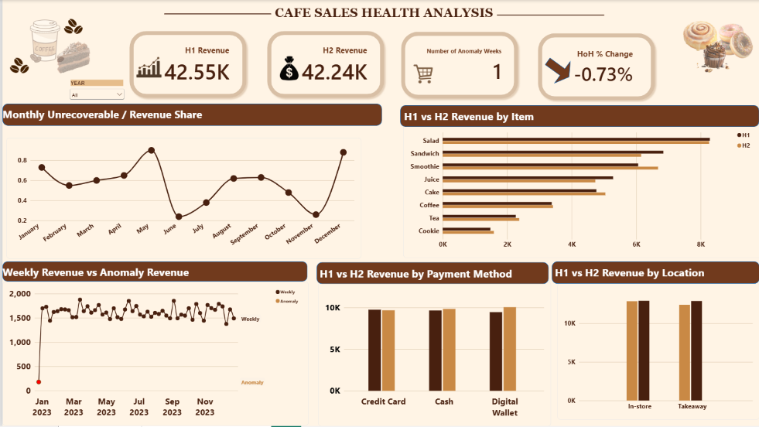
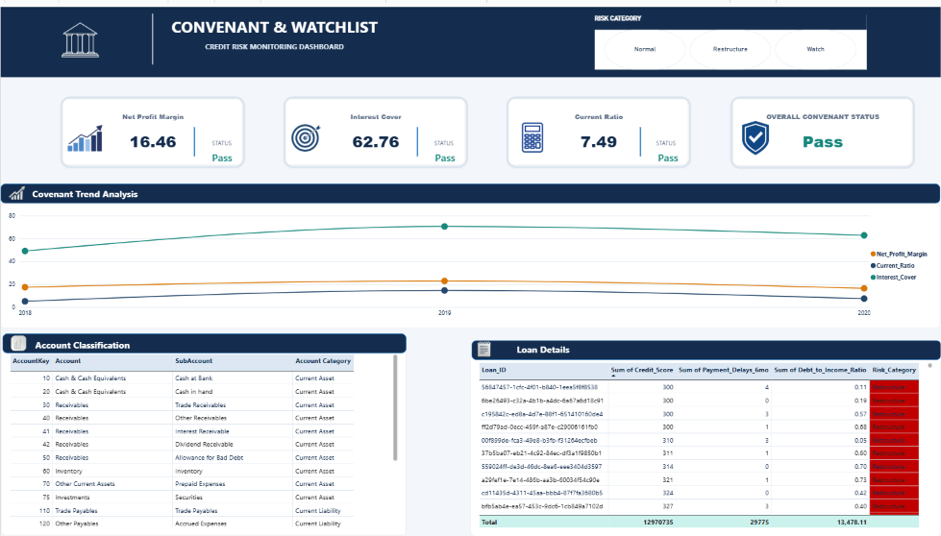

Slide 14


